Slide 1
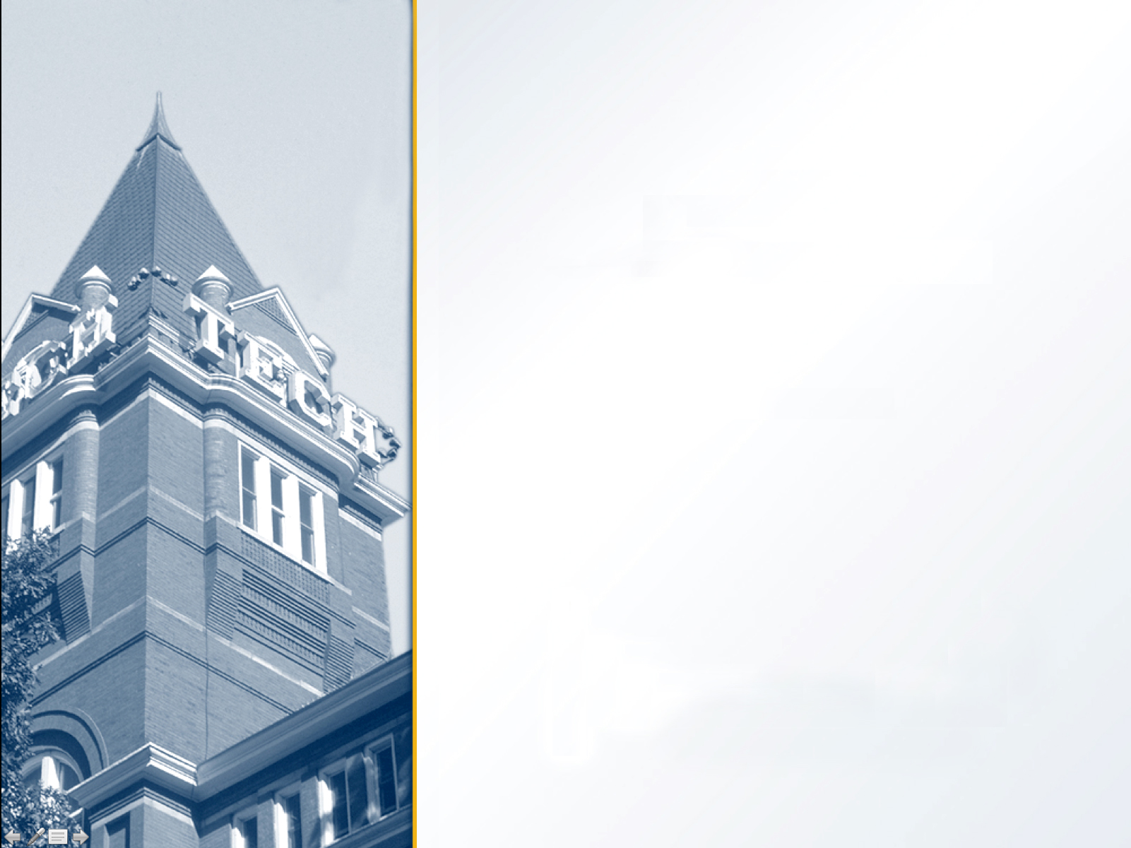
AM Transceiver Design Using USRP
Santhosh Karnik
Rahmaan Lodhia
Daniel Weiss
May 3, 2012

Slide 2

Project Objectives
Create an AM transmitter that
  Selects between microphone in and a wav file as source
  Allows frequency to be selected
Create an AM receiver that
  Plays demodulated signal through speakers
  Allows frequency to be selected

Slide 3
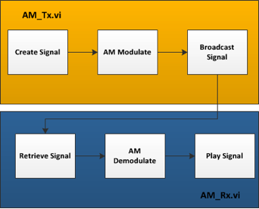
Program Overview

Slide 4
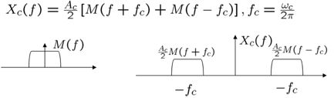
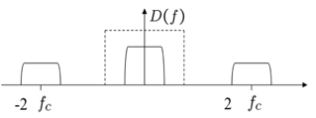
Theory
Modulation:
Spectrum of modulated signal
Spectrum of demodulated signal

Slide 5
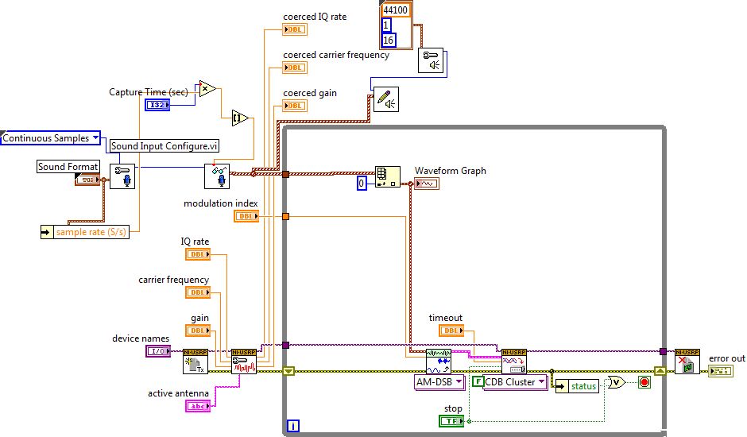
AM Tx VI version 1

Slide 6
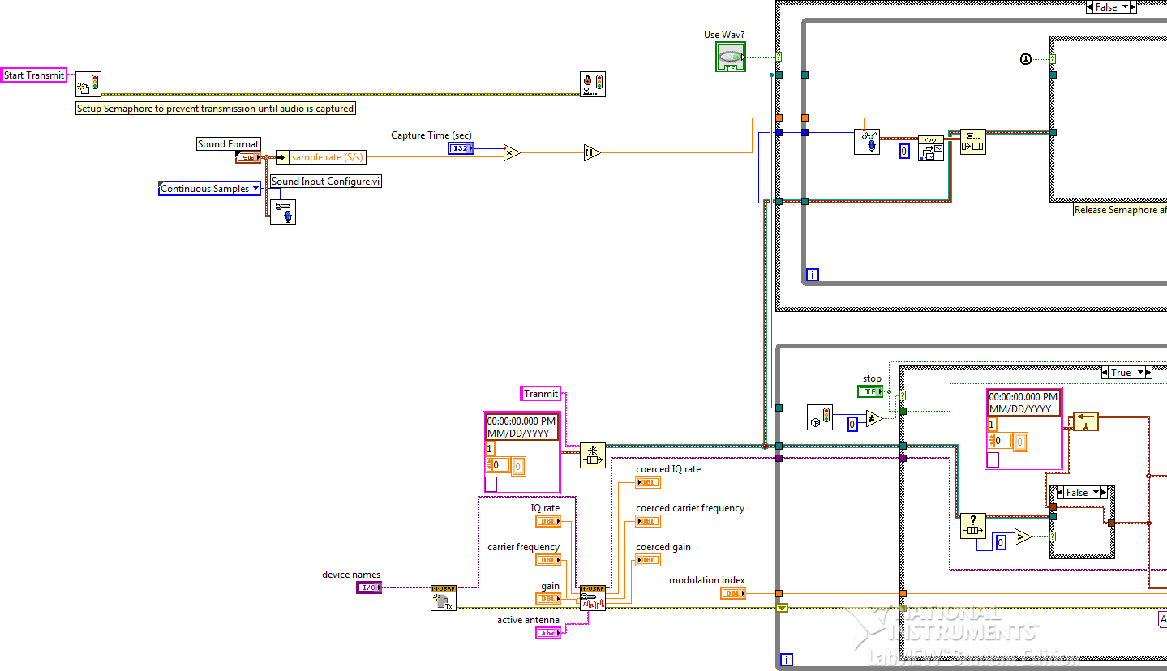
AM Tx VI version 2

Slide 7
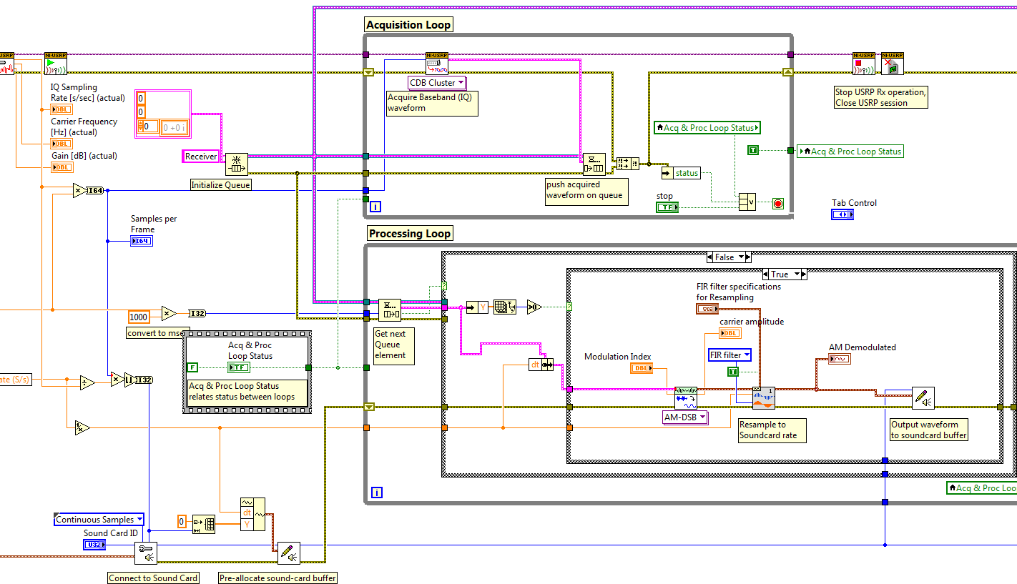
AM Rx VI

Slide 8
Problems Encountered
Analog noise
  Could be improved using band pass filter
Difficult to buffer data to be sent by USRP
Unable to receive standard AM stations

Slide 9
Future Work
Increase understanding of USRP
Protect analog audio before transmission
Filter signal prior to transmission
Determine other methods to reduce noise

